Slide 1

Security Controls
Asst.Prof.Dr.Derya BİRANT
328 - Web Based Windows Programming

Slide 2
Contents
1
Membership API
2
Using the Security Controls
3
WebSite Administration Tool

Slide 3

Membership API
The membership API is a framework based on top of the existing forms authentication infrastructure.
It provides the ability
  to create and delete users
  to reset passwords, with the possibility of sending password reset e-mails to the users
  to automatically generate passwords for users
  to find users in the underlying data store as well as retrieve lists of users and details for every user.

Slide 4
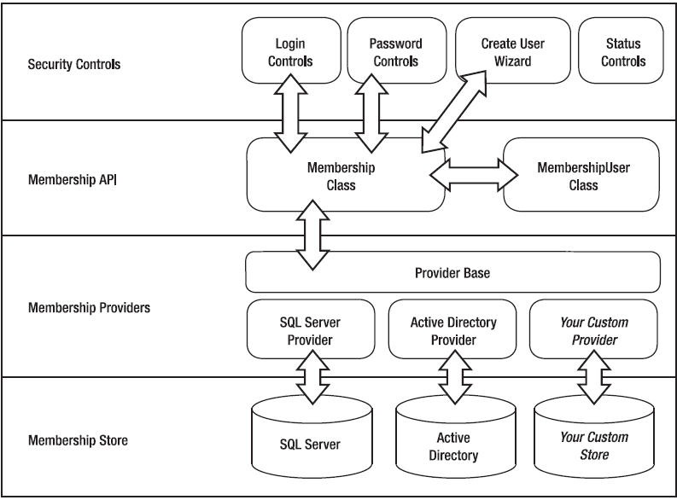
Architecture of the Membership API

Slide 5
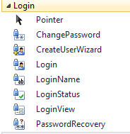
Using the Security Controls
ASP.NET simplify the process of creating login pages, for example, as well as other related pages:
  Registering users,
  Resetting passwords,
  ...

Slide 6
ASP.NET Login Controls
Control | Primary Purpose
Login | To display text boxes for the user name and password with login button and a check box that allows users to save their passwords.
LoginStatus | To display a login link for users who are not authenticated and a logout link for users who are authenticated
LoginView | To display different templates for authenticated and unauthenticated users: the AnonymousTemplate or the LoggedInTemplate.
PasswordRecovery | To retrieve the password (when users forget their passwords), if the user has provided an email address during registration.
ChangePassword | To give users a chance to change their passwords.
CreateUserWizard | To collect information from users who want to register themselves on your website.

Slide 7
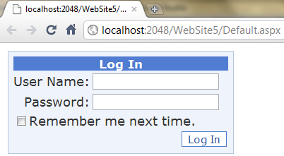
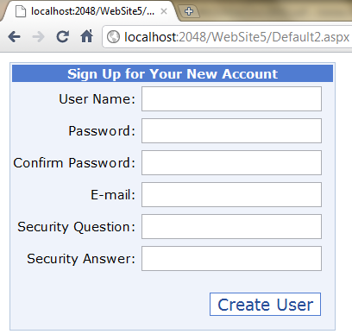
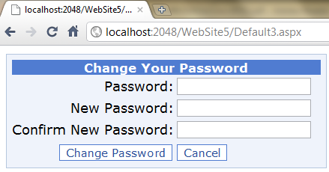
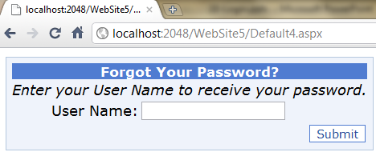
Using the Security Controls
Login
CreateUserWizard
ChangePassword
PasswordRecovery

Slide 8
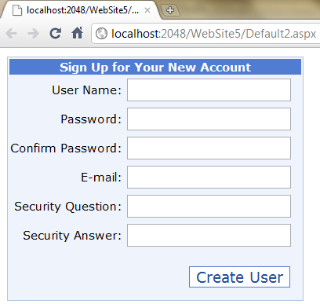
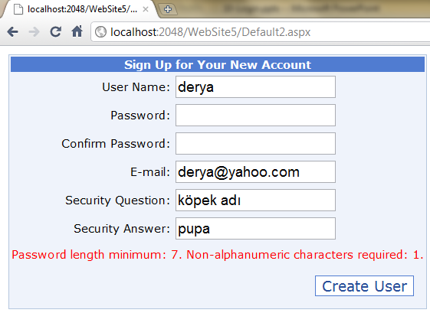
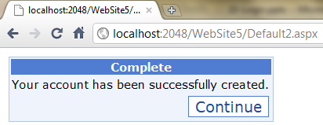
The CreateUserWizard Control
It enables you to create registration pages.
It automatically controls user entries (validation)

Slide 9
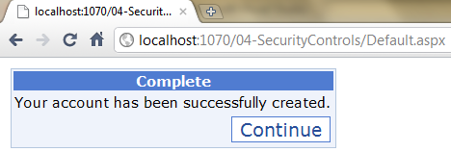
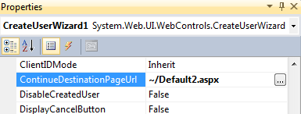
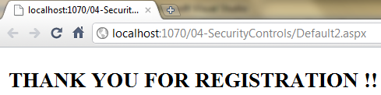
The CreateUserWizard Control
You can change ContinueDestinationPageUrl property of CreateUserWizard

Slide 10
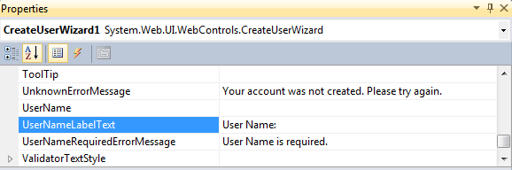
The CreateUserWizard Control
Change descriptions / language of the control
Kullanıcı Adı:

Slide 11
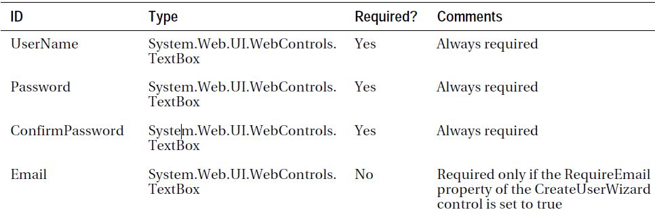

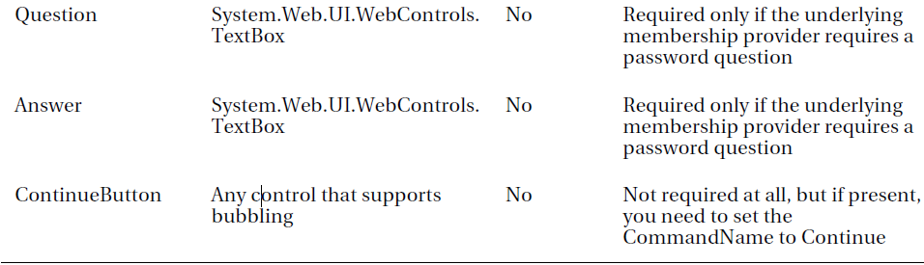
The CreateUserWizard Control

Slide 12
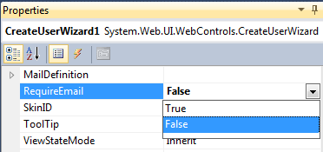
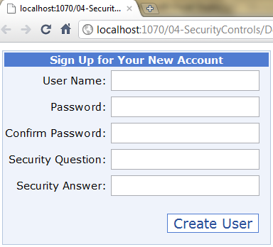
The CreateUserWizard Control
Set Require? properties
  True or
  False

Slide 13
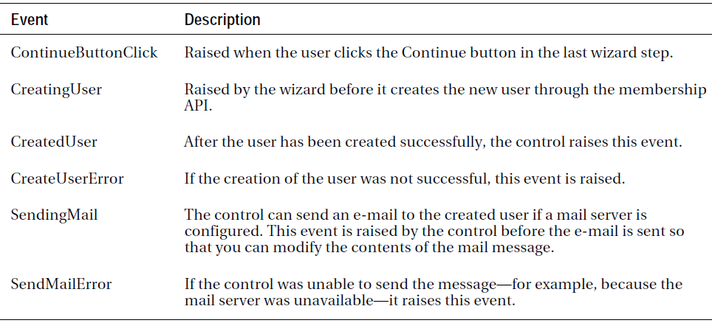
The CreateUserWizard Events

Slide 14
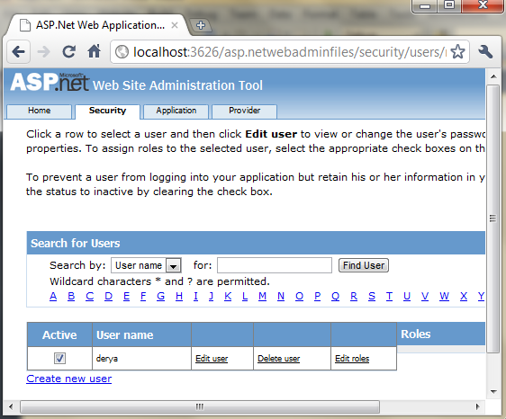
WebSite Administration Tool
Web Site ➤ ASP.NET Configuration
WebSite Administration Tool (WAT)

Slide 15
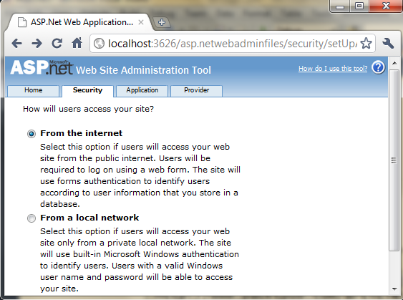
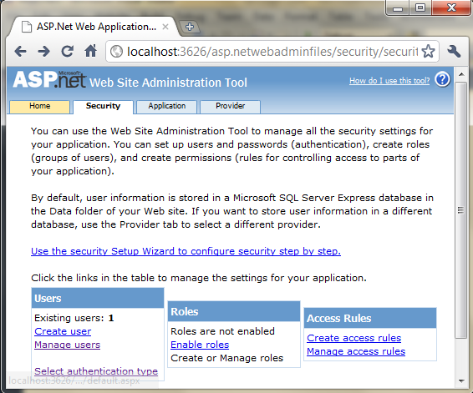
Setting up security in the WAT

Slide 16
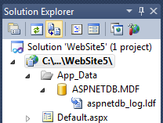
ASPNETDB.MDF Database
It uses SQL Server Express Edition
The Membership API automatically creates a new database in the App_Data special directory called ASPNETDB.MDF
when you create the first user.

Slide 17
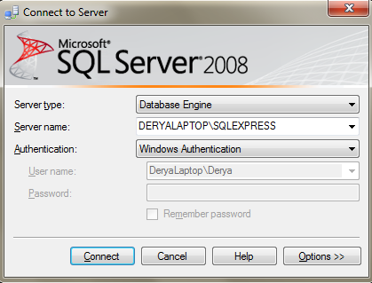
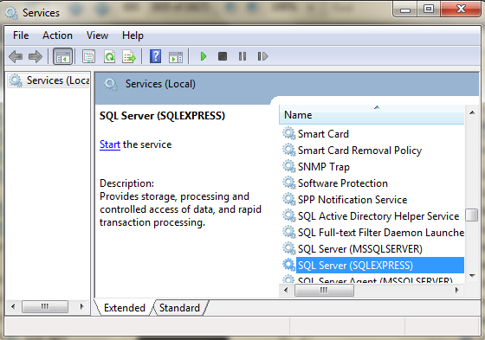
SQL Server Express Edition
Start SQL Server Express

Slide 18
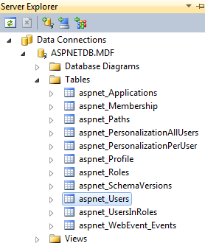
App_Data
When you create the first user, the .mdf and .ldf files will be placed in the App_Data folder.
Double click the .mdf file in the Solution Explorer.
You can see tables, edit data, all without leaving the comfort of Visual Studio.
aspnet_Users
aspnet_Membership
Tables list user names

Slide 19
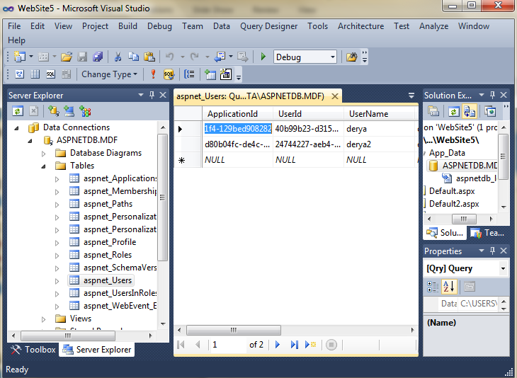

Slide 20
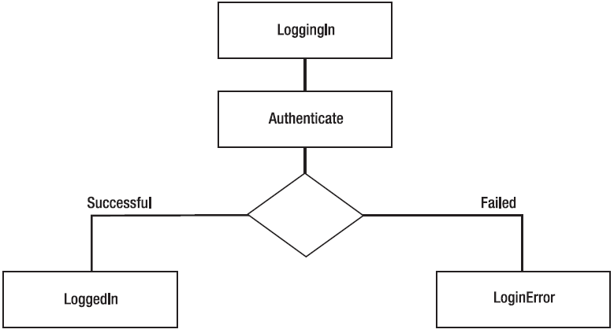
The Login Control
It provides you with a ready-to-use user interface that queries the user name and password from the user and offers a Log In button for logging the user in.

Slide 21
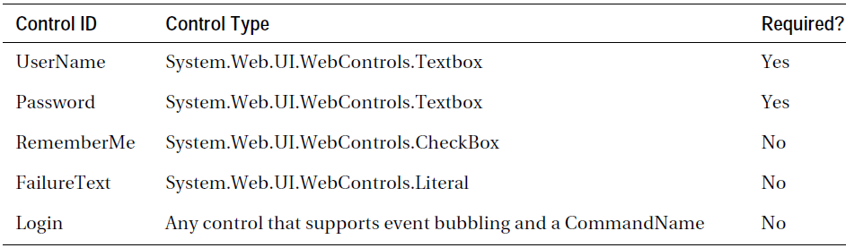
The Login Control

Slide 22
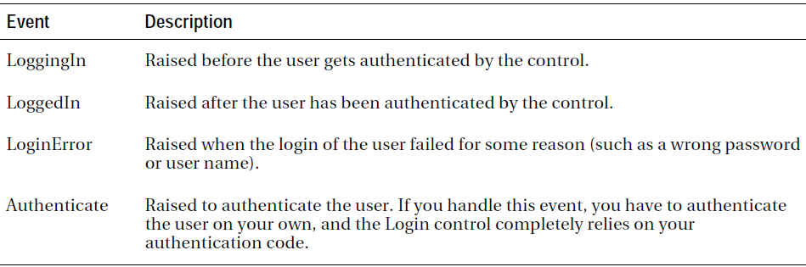
The Events of the Login Control

Slide 23

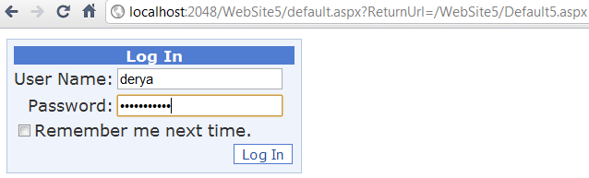

The LoginStatus Control
It displays either
  a login link if the user is not authenticated or
  a logout link if the user is authenticated.

Slide 24
The LoginStatus Control
To change login status control's login.aspx url
Write to web.config file
<authentication mode="Forms">
<forms loginUrl="Default.aspx" />
</authentication>

Slide 25
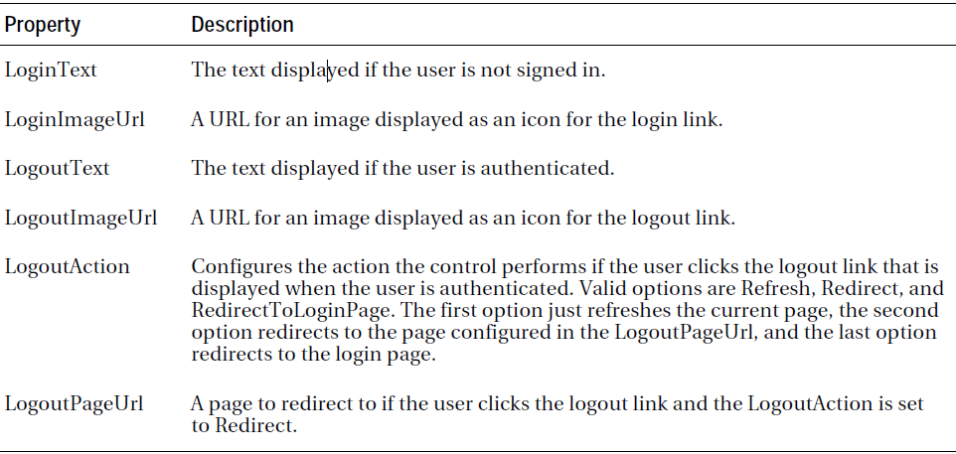
Properties the LoginStatus Control

Slide 26
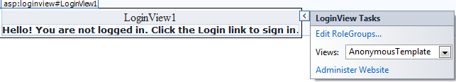
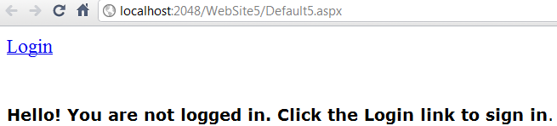
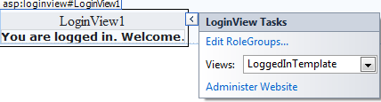
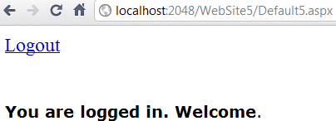
The LoginView Control
It allows you to display a different template (controls) for
  anonymous users
  authenticated users
Select AnonymousTemplate, type "Hello! You are not logged in. Click the Login link to sign in"
Click LoggedInTemplate, type "You are logged in. Welcome"
at design time
at runtime
at design time
at runtime

Slide 27
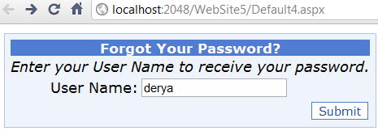
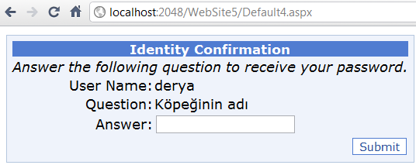
The PasswordRecovery Control
It is useful if a user has forgotten his password.
It displays the password question stored for the user.
If the user enters the correct answer, the password is mailed automatically to the e-mail address.

Slide 28
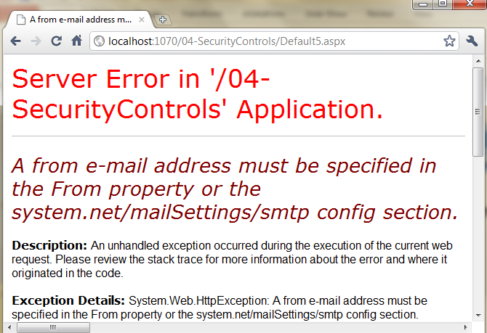
The PasswordRecovery Control
It requires an e-mail SMTP server for sending the e-mail message.

Slide 29
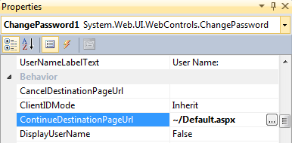
The ChangePassword Control
It allows the user to change his/her password.
It controls the old password, then it requires the user to enter the new password and confirm the new password.
In the Properties window, set ContinueDestinationPageUrl
property to ~/Default.aspx.

Slide 30
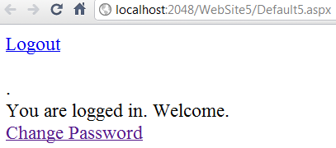
The ChangePassword Control
In the LoginView → click LoggedInTemplate
From the Toolbox, drag a HyperLink control into the editing region
In the HyperLink control, set the Text property to Change password
and the NavigateUrl property to ~/ChangePassword.aspx.

Slide 31
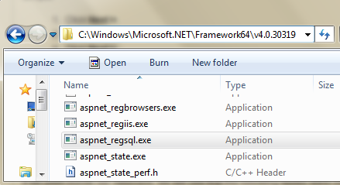
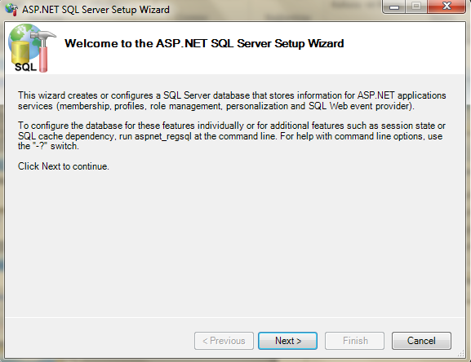
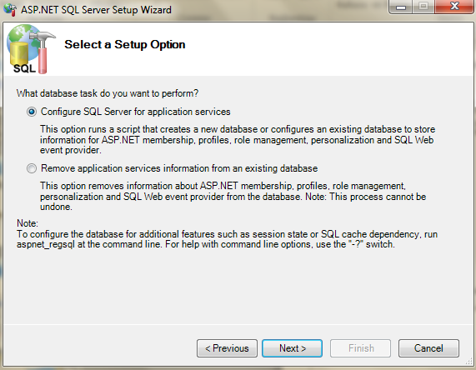
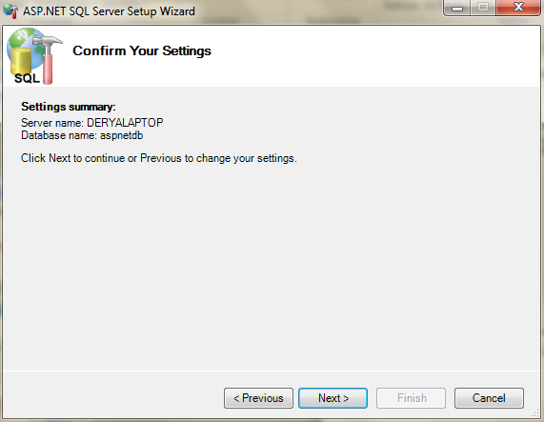
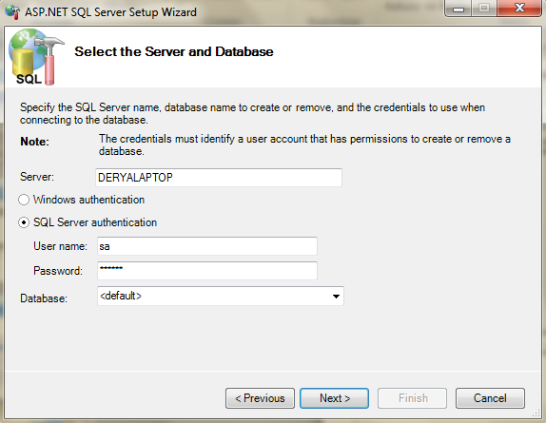
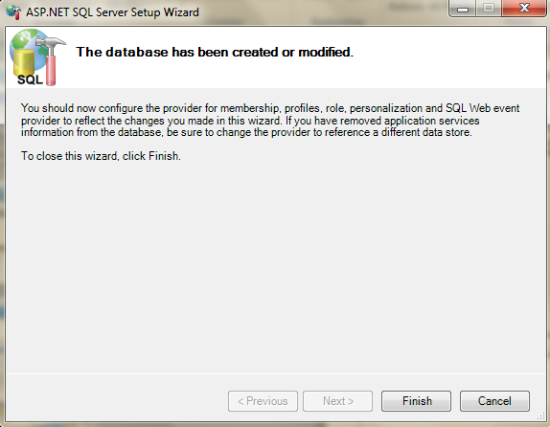
Custom Database
Instead of using default database (aspnetdb), to use a new custome database, run aspnet_regsql.exe

Slide 32
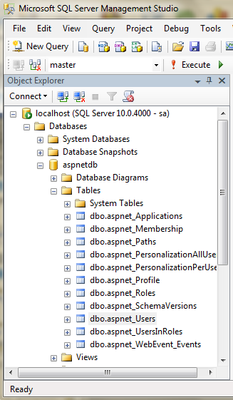
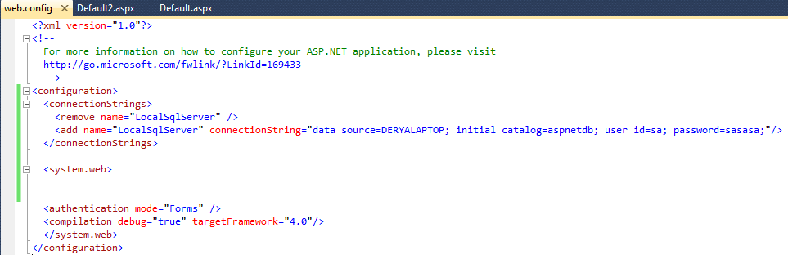
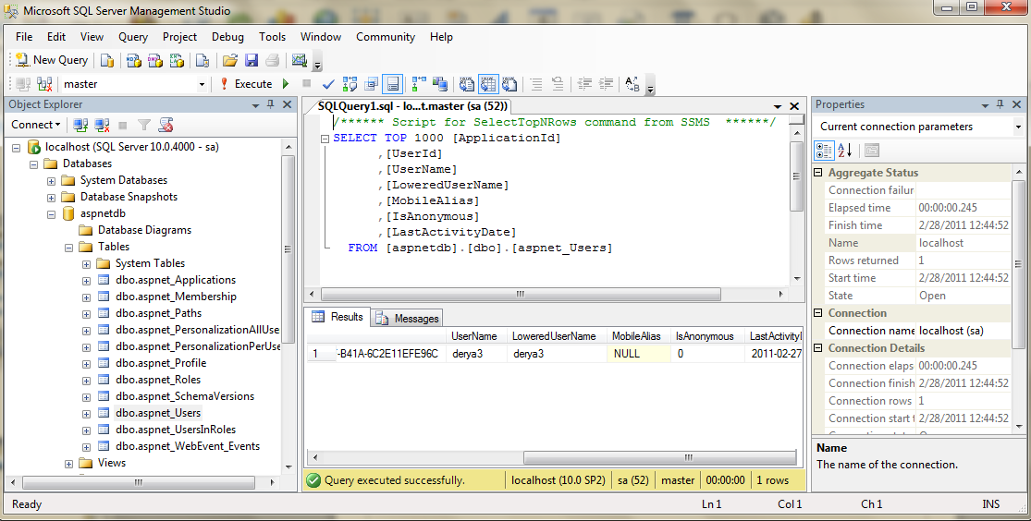
Custom Database

Slide 33
See you next week!
Asst.Prof.Dr.Derya BİRANT
328 - Web Based Windows Programming

